Slide 1
Consumers, Producers and the Efficiency of Markets

Slide 2
Consumer Surplus
Welfare Economics is the study of how the allocation of resources affects economic well being.
Willingness to pay is the maximum amount that a buyer will pay for a good.
Consumer surplus is the amount a buyer is willing to pay for a good minus the amount the buyer actually pays for it.

Slide 3
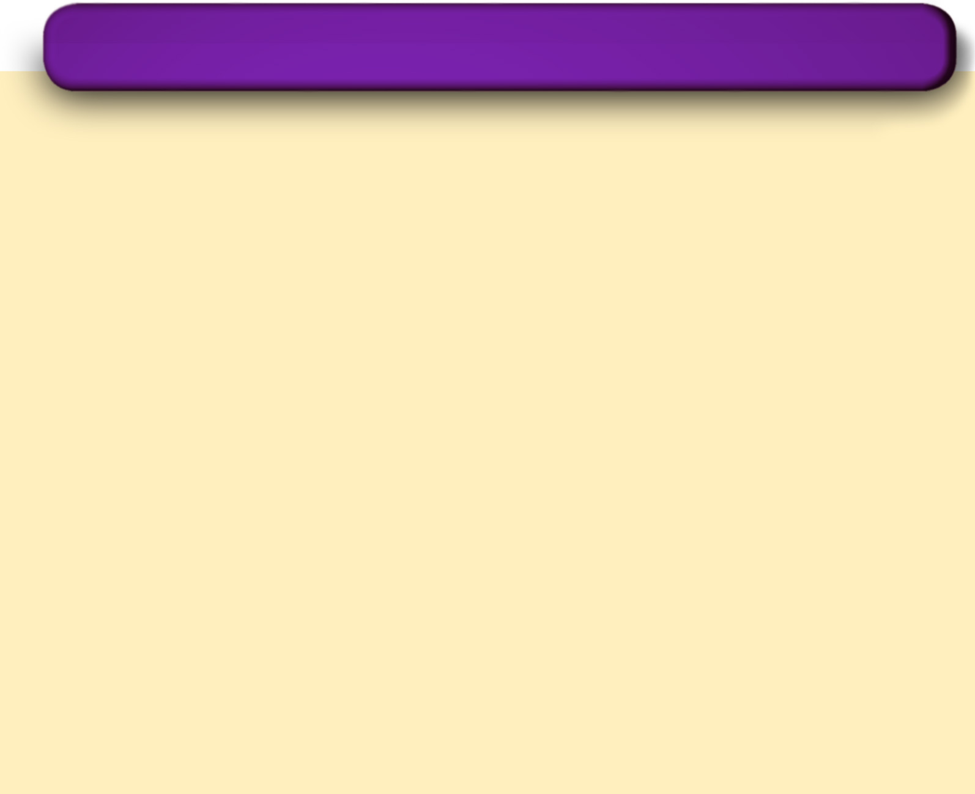
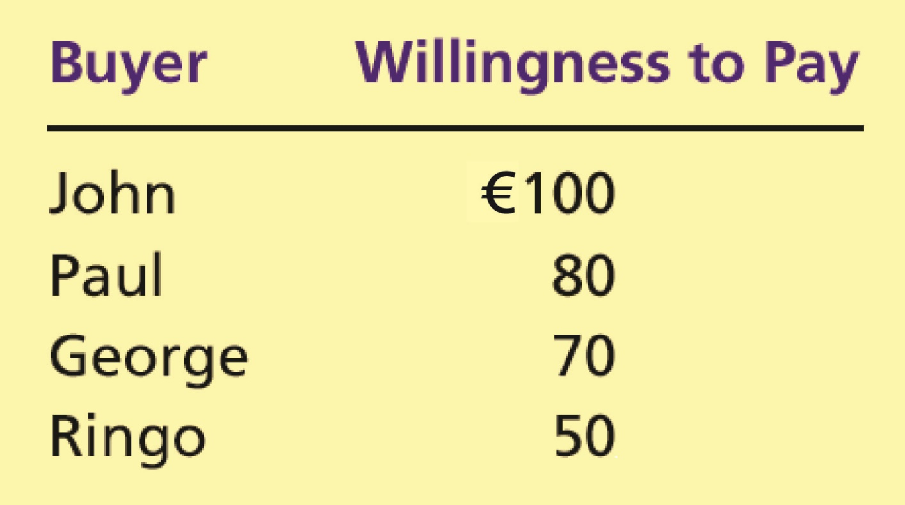
Table 1 Four Possible Buyers’ Willingness to Pay
Copyright©2004 South-Western

Slide 4
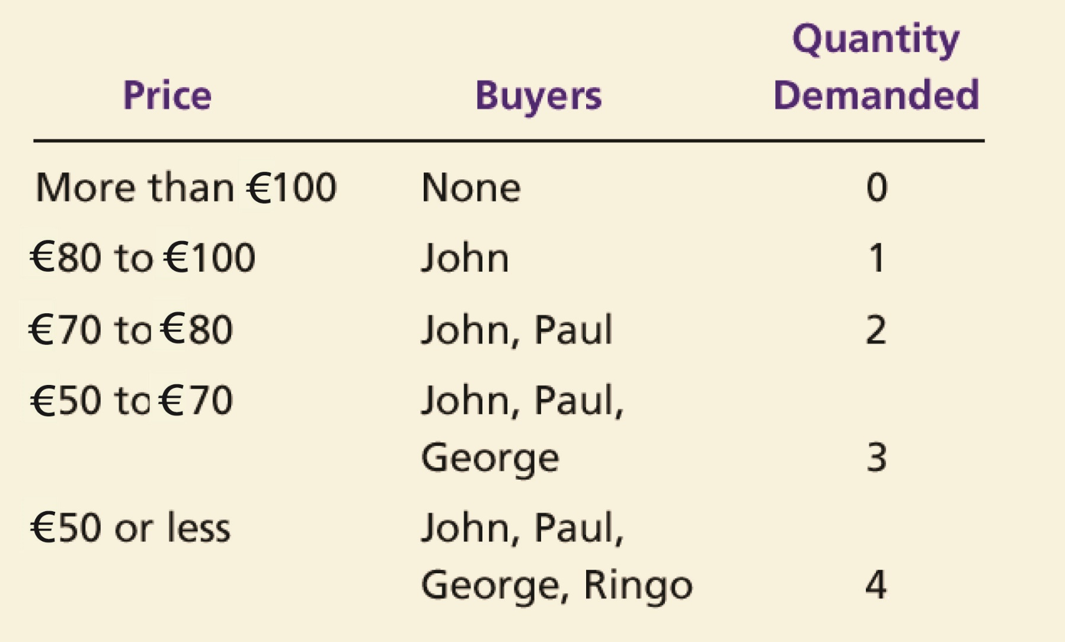
The Demand Schedule and the Demand Curve

Slide 5

Figure 1 The Demand Schedule and the Demand Curve
Price of
Album
€100
John
’
s willingness to pay
80
Paul
’
s willingness to pay
70
George
’
s willingness to pay
50
Ringo
’
s willingness to pay
Demand
0
1
2
3
4
Quantity of
Albums
Copyright©2003 Southwestern/Thomson Learning

Slide 6
Figure 2 Measuring Consumer Surplus with the Demand Curve
(a) Price = €80
Price of
Album
€100
John
’
s consumer surplus (€20)
80
70
50
Demand
0
1
2
3
4
Quantity of
Albums
Copyright©2003 Southwestern/Thomson Learning

Slide 7
Figure 2 Measuring Consumer Surplus with the Demand Curve
(b) Price = €70
Price of
Album
€100
John
’
s consumer surplus (€30)
80
Paul
’
s consumer
70
surplus (€10)
Total
50
consumer
surplus (€40)
Demand
0
1
2
3
4
Quantity of
Albums
Copyright©2003 Southwestern/Thomson Learning

Slide 8
Figure 3 How the Price Affects Consumer Surplus
(a) Consumer Surplus at Price
P
Price
A
Consumer
surplus
P₁
B
C
Demand
0
Q₁
Quantity
Copyright©2003 Southwestern/Thomson Learning

Slide 9
Figure 3 How the Price Affects Consumer Surplus
(b) Consumer Surplus at Price
P
Price
A
Initial
consumer
surplus
P₁
C
Consumer surplus
B
to new consumers
P₂
F
D
E
Additional consumer
Demand
surplus to initial
consumers
0
Q₁
Q₂
Quantity
Copyright©2003 Southwestern/Thomson Learning

Slide 10
Producer Surplus
Cost is the value of everything a seller must give up to produce a good.
Producer surplus is the amount a seller is paid for a good minus the seller’s cost of providing it.

Slide 11
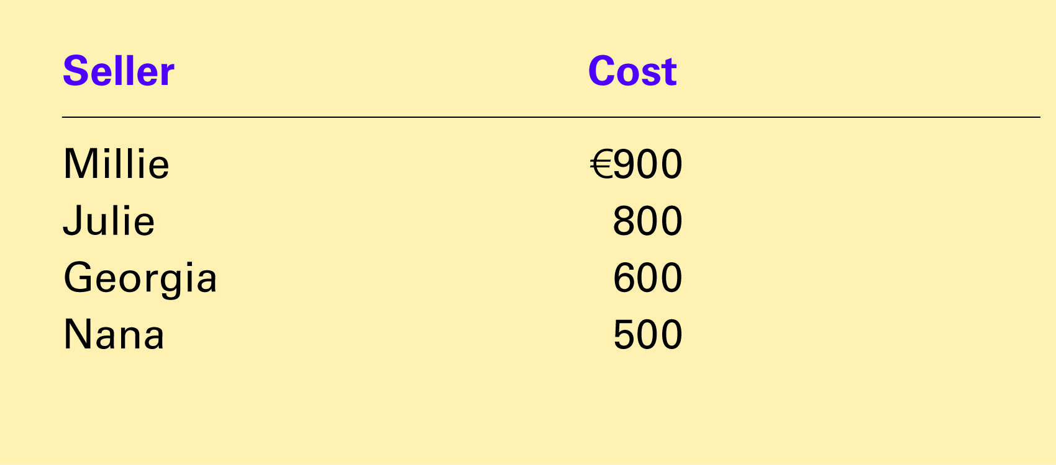
Table 2 The Costs of Four Possible Sellers
Copyright©2004 South-Western

Slide 12
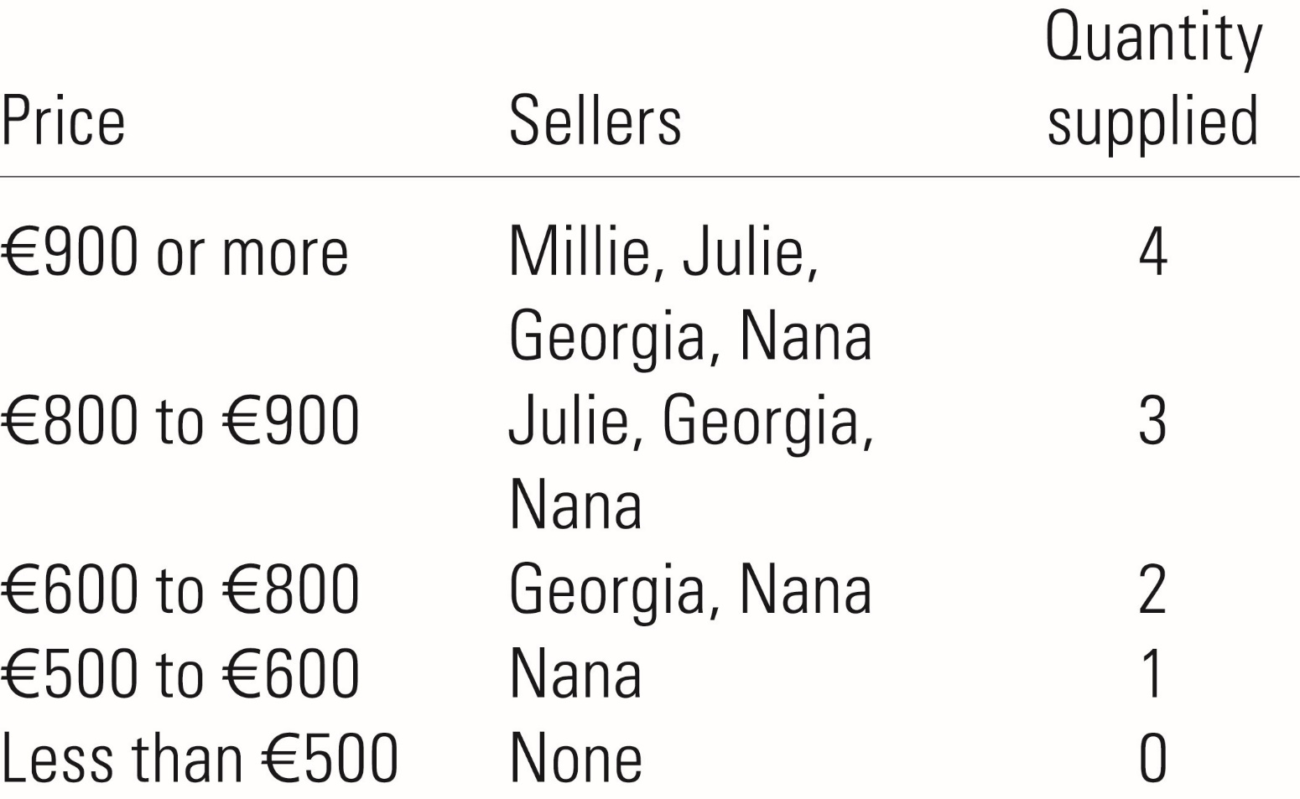
The Supply Schedule and the Supply Curve

Slide 13
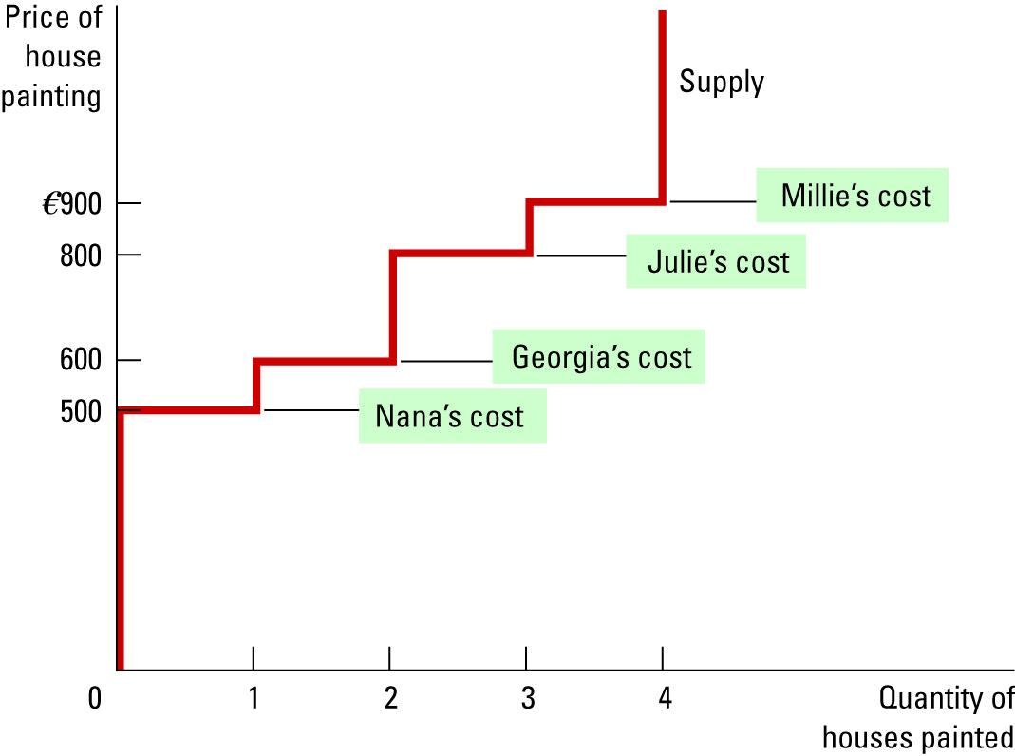
Figure 4 The Supply Schedule and the Supply Curve

Slide 14
Figure 5 Measuring Producer Surplus with the Supply Curve
(a) Price = €600
Price of
House
Painting
Supply
€900
800
600
500
Nana’s producer
’
surplus (€100)
0
1
2
3
4
Quantity of
Houses Painted
Copyright©2003 Southwestern/Thomson Learning

Slide 15
Figure 5 Measuring Producer Surplus with the Supply Curve
(b) Price = €800
Price of
House
Painting
Supply
Total
producer
€900
surplus (€500)
800
600
Georgia
’
s producer
500
surplus (€200)
Nana’s producer
’
surplus (€300)
0
1
2
3
4
Quantity of
Houses Painted
Copyright©2003 Southwestern/Thomson Learning

Slide 16
Figure 6 How the Price Affects Producer Surplus
(a) Producer Surplus at Price
P
Price
Supply
P₁
B
C
Producer
surplus
A
0
Q₁
Quantity
Copyright©2003 Southwestern/Thomson Learning

Slide 17
Figure 6 How the Price Affects Producer Surplus
(b) Producer Surplus at Price
P
Price
Additional producer
Supply
surplus to initial
producers
D
E
P₂
F
P₁
B
Initial
C
Producer surplus
producer
to new producers
surplus
A
0
Q₁
Q₂
Quantity
Copyright©2003 Southwestern/Thomson Learning

Slide 18
Figure 7 Consumer and Producer Surplus in the Market Equilibrium
Price
A
D
Supply
Consumer
surplus
Equilibrium
E
price
Producer
surplus
Demand
B
C
0
Equilibrium
Quantity
quantity
Copyright©2003 Southwestern/Thomson Learning

Slide 19
Market Efficiency- The Benevolent Social Planner
Consumer Surplus = Value to Buyers – Amount paid by buyers
Producer Surplus= Amount received by sellers-cost to sellers
Total Surplus = (Value to Buyers – Amount paid by buyers)+(Amount received by sellers-cost to sellers)
Total Surplus = Value to Buyers – Cost to Sellers

Slide 20
Efficiency vs Equality
The property of a resource allocation of maximising the total surplus received by all members of society.
The property of distributing economic prosperity uniformly among the members of society.

Slide 21
Figure 8 The Efficiency of the Equilibrium Quantity
Price
Supply
Value
Cost
to
to
buyers
sellers
Cost
Value
to
to
sellers
buyers
Demand
0
Equilibrium
Quantity
quantity
Value to buyers is greater
Value to buyers is less
than cost to sellers.
than cost to sellers.
Copyright©2003 Southwestern/Thomson Learning

Slide 22
Few Insights about market outcomes
Free market allocate the supply of goods to the buyers who value them most highly, as measured by their willingness to pay.
Free markets allocate the demand for goods to the sellers who can produce them at the lowest cost.
Free markets produce the quantity of goods that maximises the sum of consumer and producer surplus.

